Slide 1
Chapter 6
Developing an Effective Business Model
Bruce R. Barringer
R. Duane Ireland

Slide 2
Chapter Objectives
1 of 2
Describe a business model.
Explain business model innovation.
Discuss the importance of having a clearly articulated business model.
Discuss the concept of the value chain.
Identify a business model’s two potential fatal flaws.

Slide 3
Chapter Objectives
2 of 2
Identify a business model’s four major components.
Explain the meaning of the term business concept blind spot.
Define the term core competency and describe its importance.
Explain the concept of supply chain management.
Explain the concept of fulfillment and support.

Slide 4
What is a Business Model?
Model
A model is a plan or diagram that’s used to make or describe something.
Business Model
A firm’s business model is its plan or diagram for how it competes, uses its resources, structures its relationships, interfaces with customers, and creates value to sustain itself on the basis of the profits it generates.
The term “business model” is used to include all the activities that define how a firm competes in the marketplace.

Slide 5
Beyond Its Own Boundaries
It’s important to understand that a firm’s business model takes it beyond its own boundaries.
Almost all firms partner with others to make their business models work. In Dell’s case, it needs the cooperation of its suppliers, customers, and many others to make its business model possible.
Company’s business model involves its network of partners along with its products. It encompasses the capabilities of multiple individuals and entities, all of which must be willing and motivated to play along.
An example is Apple and in particular the Apple App Store.

Slide 6
Diversity of Business Models
There is no standard business model for an industry or for
a target market within an industry.
However, over time, the most successful business models
in an industry predominate.
There are always opportunities for business model innovation.
Diversity or Variety in Business Models

Slide 7

Business Model Innovation
Business model innovation refers to a business model that revolutionizes how a product is produced, sold, or supported after the sale.
Netflix in movie rentals,
Amazon.com’s Kindle in digital books and Apple’s iTunes in the way music is purchased are familiar examples of successful business model innovations.

Slide 8
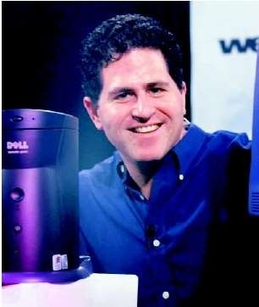
Dell’s Business Model
To achieve long-term success though, all business models need to be modified across time.
Competitors can eventually learn how to duplicate the benefits a particular firm is able to create through its business model.
Competitors such as Hewlett Packard had learned how to successfully duplicate the benefits of Dell Inc.’s “build-to-order” (BTO) business model.

Slide 9
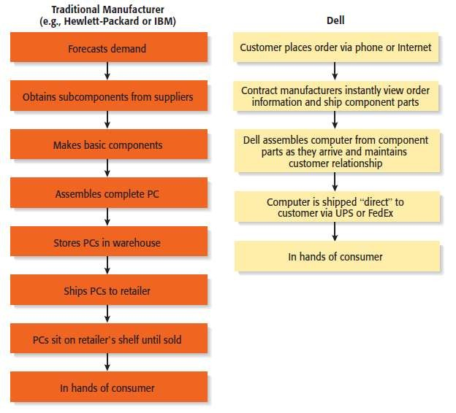
Dell’s Business Model
Dell’s Approach to Selling PCs versus Traditional Manufacturers

Slide 10
Firms are continually introducing business model innovations to find ways to add value in unique ways and revolutionize how products and services are sold in their industries.
A firm’s business model is developed after the feasibility analysis stage of launching a new venture. The business model stage addresses how to surround it with a core strategy, a partnership model, a customer interface, distinctive resources, and an approach to creating value that represents a viable business.

Slide 11
The Importance of Business Models
Having a clearly articulated business model is important because it does the following:
Serves as an ongoing extension of feasibility analysis. A business model continually asks the question, “Does this business make sense?”
Focuses attention on how all the elements of a business fit together and constitute a working whole.
Describes why the network of participants needed to make a business idea viable is willing to work together.
Articulates a company’s core logic to all stakeholders, including
all employees.

Slide 12
How Business Models Emerge
The Value Chain
The value chain is the string of activities that moves a product from the raw material stage, through manufacturing and distribution, and ultimately to the end user.
By studying a product’s or service’s value chain, an organization can identify ways to create additional value and assess whether it has the means to do so.
Value chain analysis is also helpful in identifying opportunities for new businesses and in understanding how business models emerge.

Slide 13
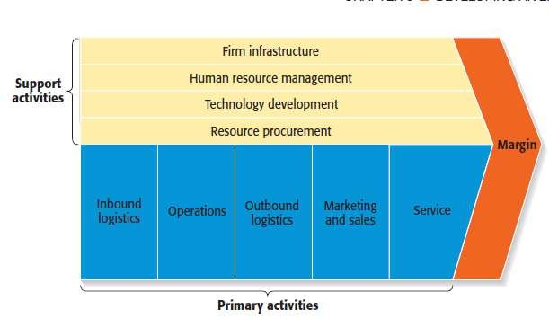
How Business Models Emerge
The Value Chain

Slide 14
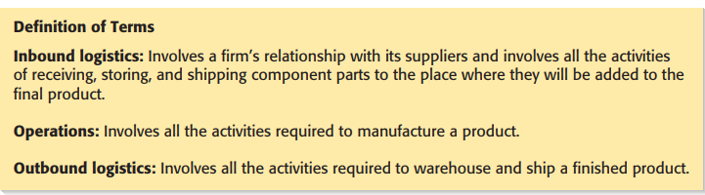

Slide 15
How Business Models Emerge
The Value Chain (continued)
Entrepreneurs look at the value chain of a product or a service to pinpoint where the value chain can be made more effective or to spot where additional “value” can be added.
This type of analysis may focus on:
A single primary activity such as marketing and sales.
The interface between one stage of the value chain and another, such as the interface between operations and outgoing logistics.
One of the support activities, such as human resource management.

Slide 16
How Business Models Emerge
The Value Chain (continued)
If a product’s value chain can be strengthened in any one of these areas, it may represent an opportunity for the formation of a new firm to perform that activity.
Example: FedEx, Outbound logistics,
To provide new ways to warehouse and move goods effectively to the end user.

Slide 17
Potential Fatal Flaws in Business Models
Fatal Flaws
Two fatal flaws can render a business model unsupportable from the beginning:
A complete misread of the customer.
Utterly unsound economics.

Slide 18
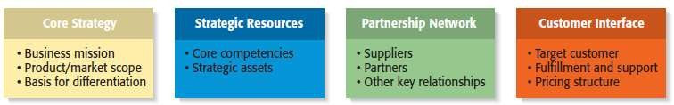
Components of an Effective Business Model
Four Components of a Business Model

Slide 19
Core Strategy
1 of 3
Core Strategy
The first component of a business model is the core strategy, which describes how a firm competes relative to its competitors.
Primary Elements of Core Strategy
Mission statement.
Product/market scope.
Basis for differentiation.

Slide 20
Core Strategy
2 of 3
Primary Elements of Core Strategy
Mission Statement | A firm’s mission, or mission statement, describes why it exists and what its business model is supposed to accomplish.
Product/Market Scope | A company’s product/market scope defines the products and markets on which it will concentrate.

Slide 21
Core Strategy
3 of 3
Primary Elements of Core Strategy
It is important that a new venture differentiate itself from its competitors in some way that is important to its customers. If a new firm’s products or services aren’t different from those of its competitors, why should anyone try them?
Firms typically choose one of two generic strategies (cost leadership or differentiation)
Basis of Differentiation

Slide 22
Strategic Resources
1 of 3
Strategic Resources
A firm is not able to implement a strategy without adequate resources, so the firm’s resources substantially affect how its business model is used.
For a new venture, its strategic resources may initially be limited to the competencies of its founders, the opportunity they have identified, and the unique way they plan to service their market.
The two most important strategic resources are:
A firm’s core competencies.
Strategic assets.

Slide 23
Strategic Resources
2 of 3
Primary Elements of Strategic Resources
Core Competencies | A core competency is a resource or capability that serves as a source of a firm’s competitive advantage over its rivals. Examples include Apple’s competence in designing consumer products, Netflix’s competence in supply chain management., or Dell’s competence in supply chain management.
Strategic Assets | Strategic assets are anything rare and valuable that a firm owns. They include plant and equipment, location, brands, patents, customer data, a highly qualified staff, and distinctive partnerships.

Slide 24
Strategic Resources
3 of 3
Importance of Strategic Resources
Companies ultimately try to combine their core competencies and strategic assets to create a sustainable competitive advantage.
This factor is one that investors pay close attention when evaluating a business.
A sustainable competitive advantage is achieved by implementing a value-creating strategy that is unique and not easy to imitate.
This type of advantage is achievable when a firm has strategic resources and the ability to use them in unique ways that create value for a group of targeted customers.

Slide 25
Partnership Network
1 of 3
Partnership Network
A firm’s partnership network is the third component of a business model. New ventures, in particular, typically do not have the resources to perform key roles.
In most cases, a business does not want to do everything itself because the majority of tasks needed to build a product or deliver a service are not core to a company’s competitive advantage.
A firm’s partnership network includes:
Suppliers.
Other key relationships/ partners.

Slide 26
Partnership Network
2 of 3
Primary Elements of Partnership Network
Suppliers | A supplier is a company that provides parts or services to another company. A supply chain is the network of all the companies that participate in the production of a product, from the acquisition of raw materials to the final sale. The more efficiently an organization can manage its supply chain, the more effectively its entire business model will perform. Intel is Dell’s primary supplier of computer chips.
Other Key Relationships | Firms partner with other companies to make their business models work. An entrepreneur’s ability to launch a firm that achieves a competitive advantage may hinge as much on the skills of the partners as on the skills within the firm itself.

Slide 27
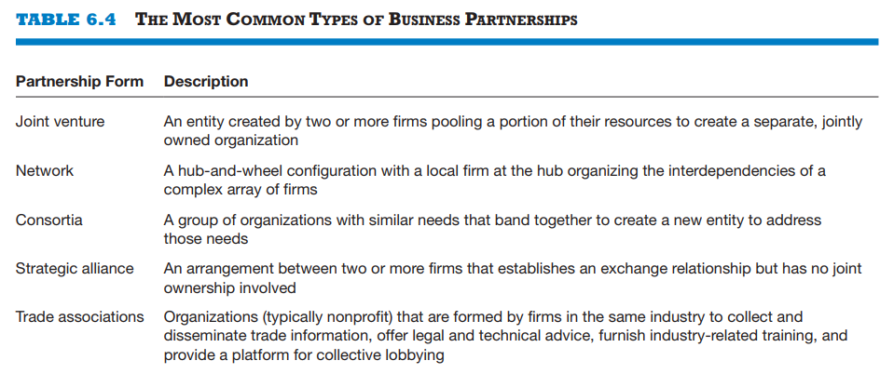

Slide 28
Customer Interface
1 of 3
Customer Interface
How a firm interacts with its customers, the type of customer interaction depends on how a firm chooses to compete.
For example, Amazon.com sells books over the Internet while Barnes & Noble sells through its traditional bookstores and online.
Sometimes a company’s customer interface will change as conditions change. Ex: Apple Stores
The three elements of a company’s customer interface are:
Target market.
Fulfillment and support.
Pricing structure.

Slide 29
Customer Interface
2 of 3
Primary Elements of Customer Interface
Target Market | A firm’s target market is the limited group of individuals or businesses that it goes after or tries to appeal to.
Fulfillment and Support | Fulfillment and support describes the way a firm’s product or service reaches its customers. It also refers to the channels a company uses and what level of customer support it provides. All these issues impact the shape and nature of a company’s business model.

Slide 30
Customer Interface
3 of 3
Primary Elements of Customer Interface
Pricing Structure
The third element of a company’s customer interface is its pricing structure. Pricing models vary, depending on a firm’s target market and its pricing philosophy.

Slide 31
Recap: The Importance of Business Models
Business Models
It is very useful for a new venture to look at itself in a holistic manner and understand that it must construct an effective “business model” to be successful.
Everyone that does business with a firm, from its customers to its partners, does so on a voluntary basis. As a result, a firm must motivate its customers and partners to play along.
Close attention to each of the primary elements of a firm’s business model is essential for a new venture’s success.

